Slide 1
Giant Eagle
Curbside Express Customer Retention
CMU Student Lab
Final Presentation, December 5, 2019

Slide 2







CMU Student Team
Aditi Mahajan
Tepper’20
Ankush Batra
Tepper’20
Arushi Vyas
Heinz’19
Yamuna Bhaskar
Heinz’19
Team Coordinator
Darshit Doshi
Heinz’19
Dhara Shah
Heinz’19
Kartik Joshi
Tepper’20

Slide 3



Advisory Team
Marcel Krutil
A.T. Kearney
Coach
Prof. Sunder Kekre
Tepper School
Faculty Advisor
Prof. T.K. Lim
Heinz College
Faculty Advisor
‹#›

Slide 4
Agenda
Problem Statement
Framework
Data Preprocessing
Feature Selection
Customer Segmentation
Customer Personas
Curbside Likelihood Model
Business Value
Q&A

Slide 5
Problem Statement

Slide 6
Problem Statement
Complication
We don’t know the characteristics of the customers who shop on curbside to get them to engage more.
Question
How can we segment the curbside customers to have more targeted marketing solutions?
Situation
Curbside sales have become stagnant over the past two years and Giant Eagle is looking for avenues to increase curbside engagement of customers.

Slide 7
Framework

Slide 8
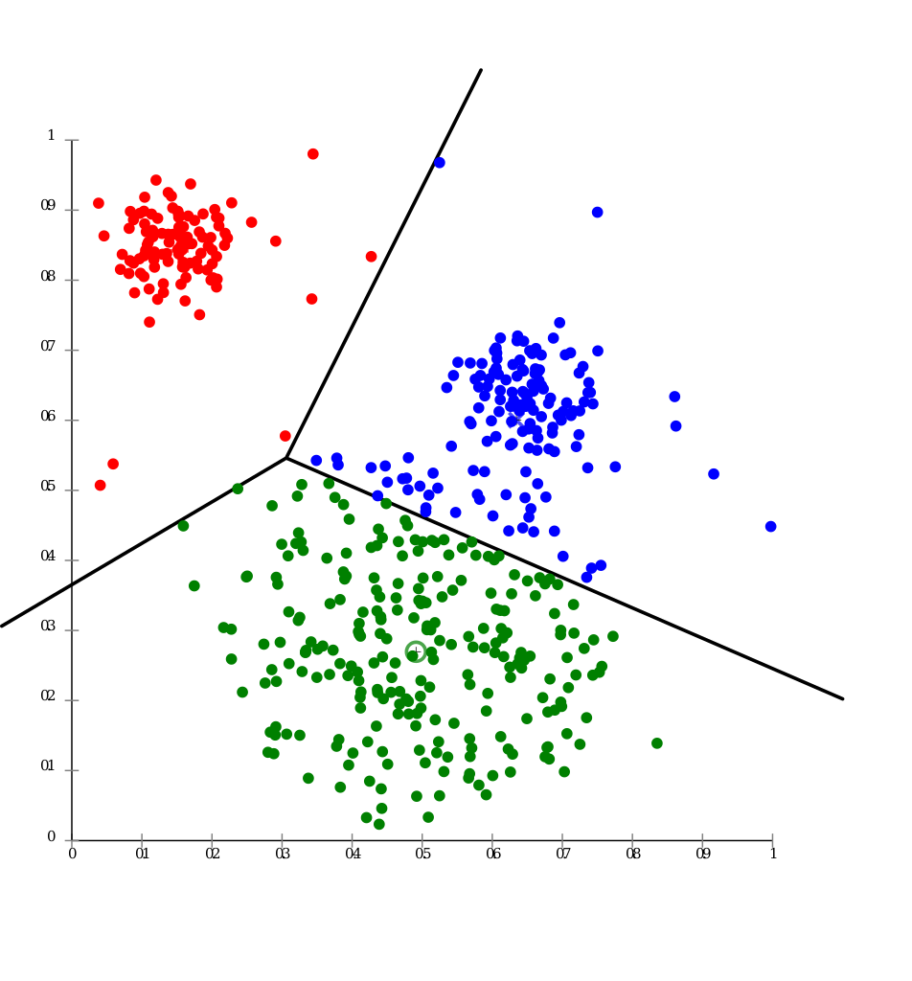
Customer Segmentation & Profiling
Iterate
Step 1
Step 2
Step 3
Step 4
Define Segmentation Objective
To find attributes that make Curbside customers stick and not stick.
Data Preparation
Decide on segmentation variables.
Hypothesis testing, statistical tools to measure data continuity, etc.
Model Creation
Factor reduction
Clustering analysis
Segment Profiling
Infer which attributes make customers stick and not stick.
Provide these to GE to help plan for future marketing strategies.

Slide 9
Feature Selection & Data Preprocessing

Slide 10
Feature Selection - Issue Tree
Curbside Customer Behavior
Household Buying Behavior
Household Demographics
Store Demographics
Purchase frequency
Avg. order amount
Product mix
Curbside fee
Pick-up vs Delivery
Promotional sensitivity
Value Score
Income
Age
# of adults
# of children
Occupation
Education
Competition
Proximity
Store type (size)
Available departments
Note: Features ranked in order of perceived priority.

Slide 11
Data Processing - Approach
Transformed Data
Raw Data Files
Purchase Frequency
Product mix
Income
Age
Education
Null Treatment
Household Buying Behavior
Merged file with selected variable
Household Demographics
Merging
Promotional Sensitivity
Income
# of Adults
Education
Store Demographics
Segmentation

Slide 12
Customer Segmentation

Slide 13
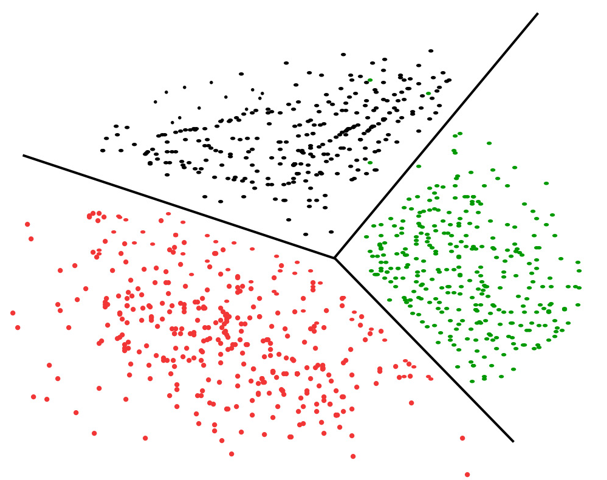


K-Means Clustering
Transformed Data
Purchase Frequency
Product mix
Income
Age
Education
Promotional Sensitivity
Income
# of Adults
Education
Clusters/Personas
Clustering Model

Slide 14
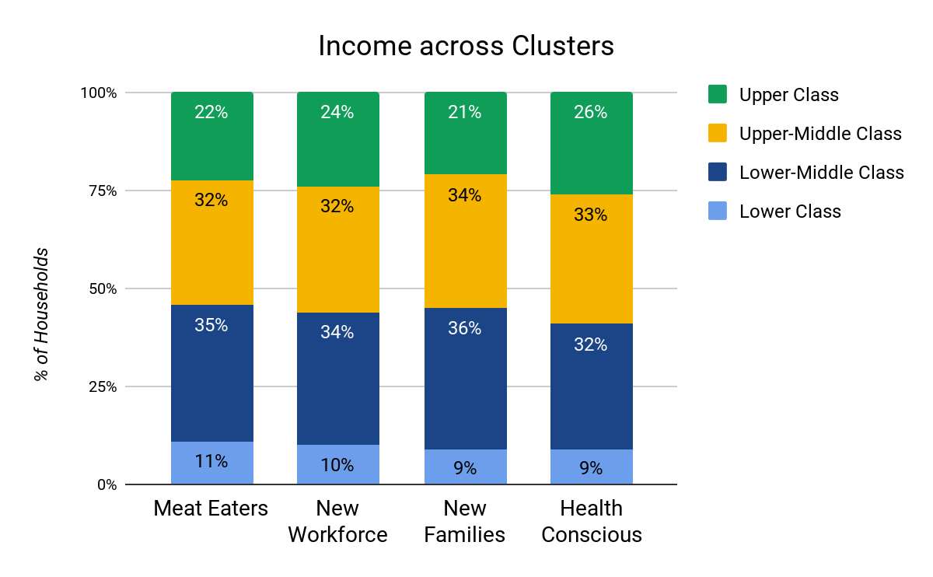
Income Summary

Slide 15
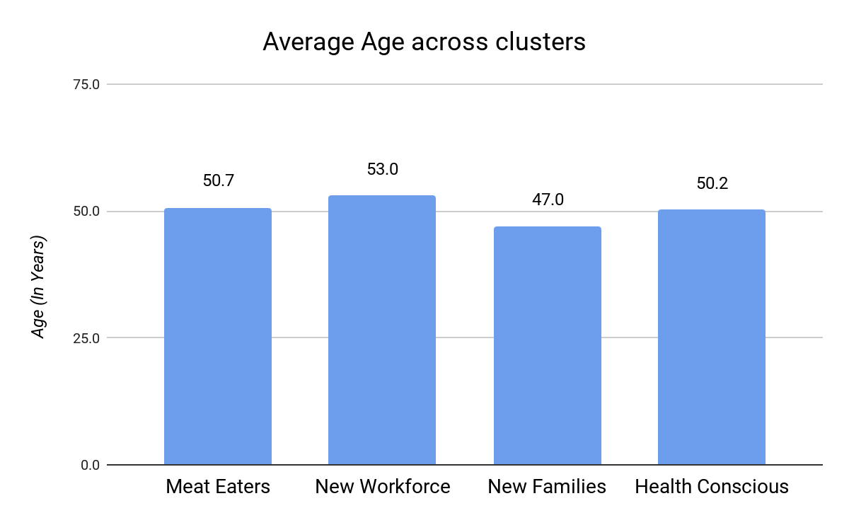
Average Age Summary

Slide 16
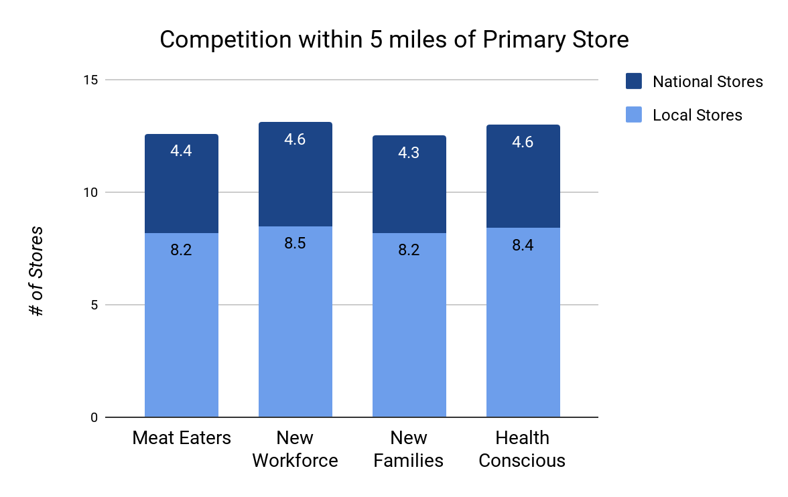
Competition Summary

Slide 17
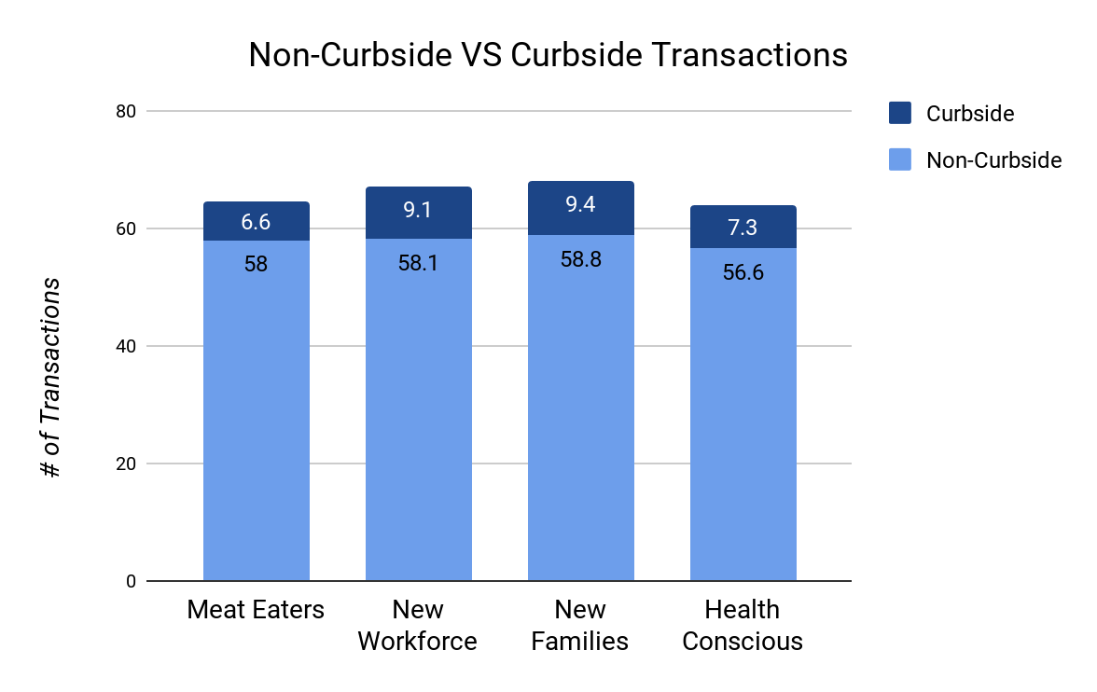
Number of Transactions Summary

Slide 18
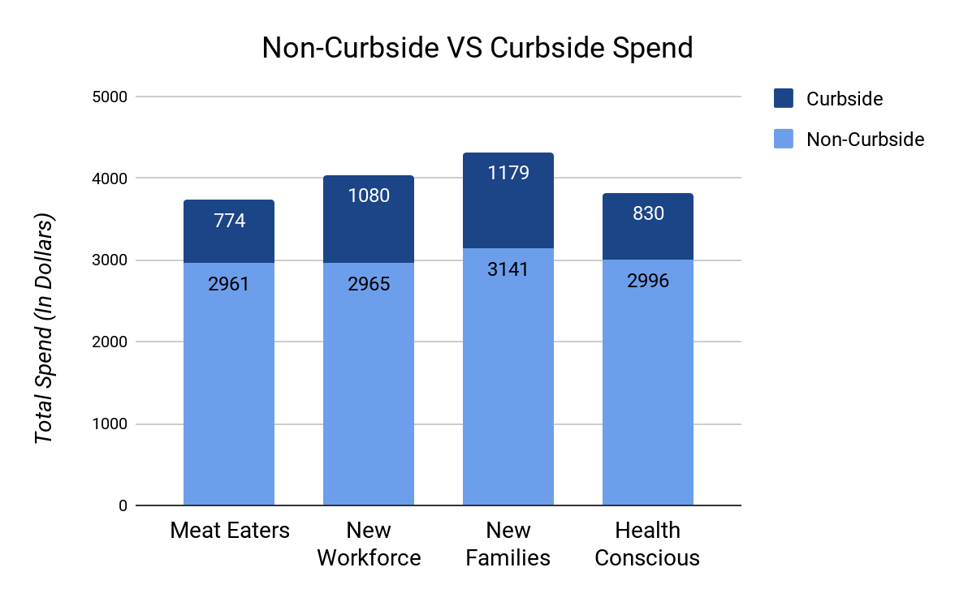
Total Spend Summary

Slide 19
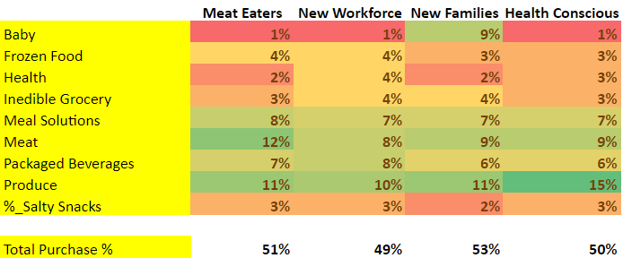
Highly Significant Products: Non-Curbside

Slide 20
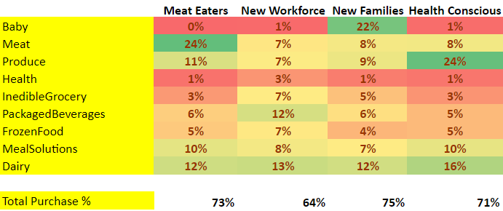
Highly Significant Products: Curbside

Slide 21
Customer Personas

Slide 22

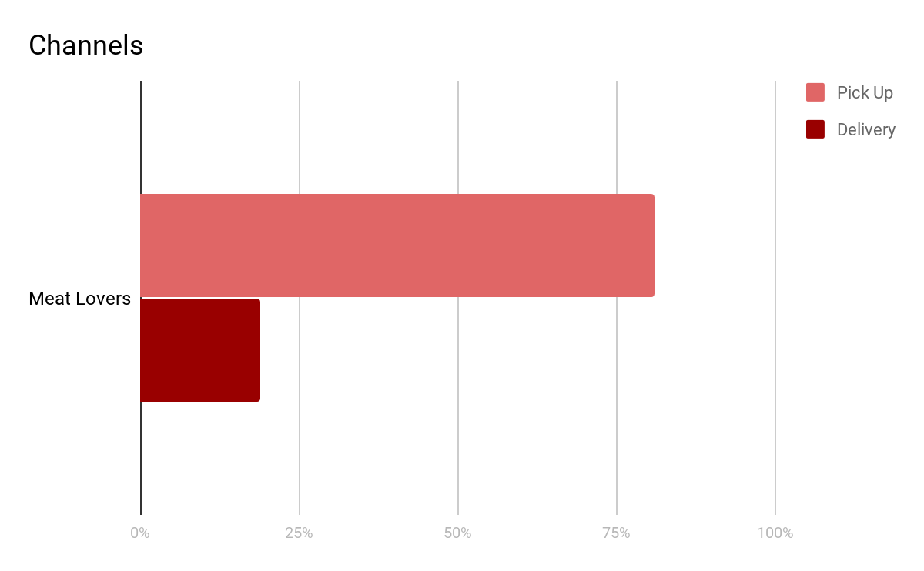
Customer Personas (1/4): Meat Eaters
Prefer Meal Solutions
Small households
Avg. Curbside Spend: $774
Percentage of households: 27%

Slide 23

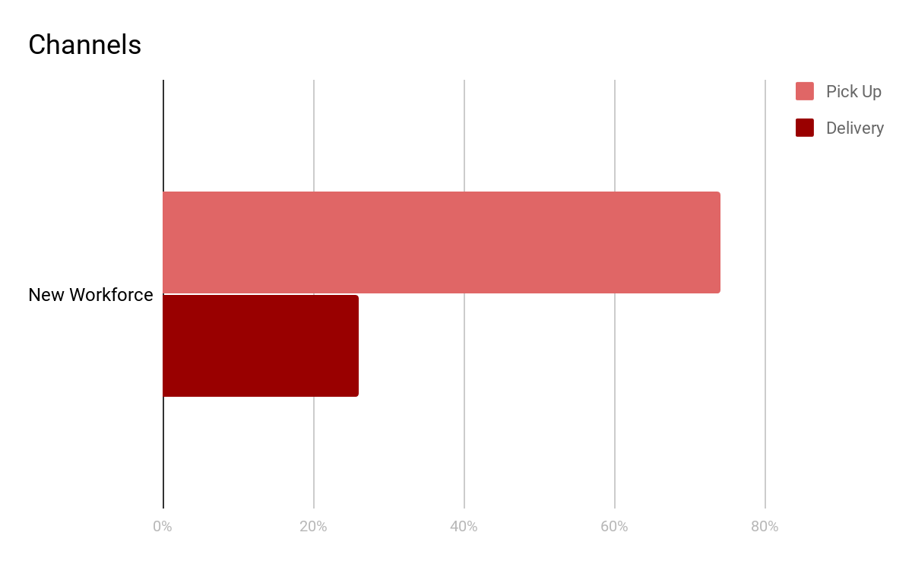
Customer Personas (2/4): New Workforce
Packaged food buyers
Busy Schedules
Avg. Curbside Spend: $1080
Percentage of households: 39.5%

Slide 24


Customer Personas (3/4): New Families
New Families
Larger households
Avg. Curbside Spend: $1179
Percentage of households: 2.4%

Slide 25

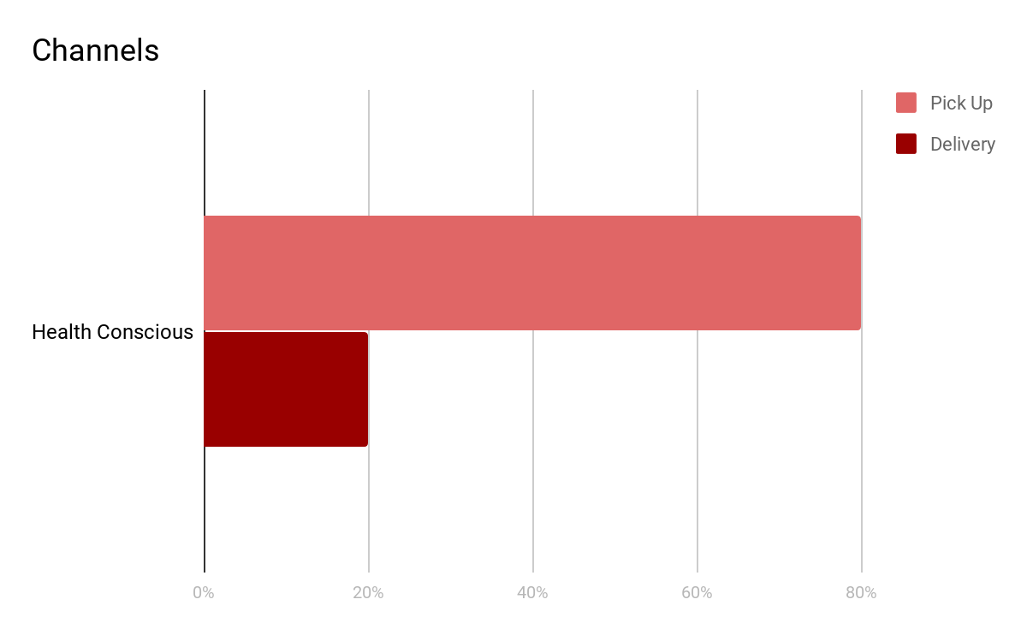
Customer Personas (4/4): Health Conscious
Buy Fresh Produce and Dairy
Small households
Avg. Curbside Spend: $830
Percentage of households: 30.6%

Slide 26
Curbside Likelihood Model

Slide 27

Curbside Likelihood Prediction
Non-curbside Households
Curbside Households
How many non-curbside households will shift to curbside?
How many non-curbside households are similar to curbside households?

Slide 28
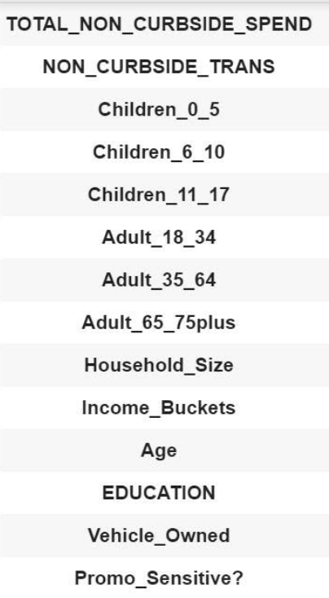
Curbside Likelihood Prediction
Linear Regression Model
Predicted Curbside Spend of Non-curbside Households
Training Data: Curbside Households
Test Data: Non-curbside Households

Slide 29
Curbside Likelihood Prediction
Independent Variables | Coefficient Value
Promotional Sensitivity | -356
No. adult 18 to 34 years | -272
No. adult 65 plus years | -92
No. children 11 to 17 years | -25
No. children up to 5 years | -16
No. adult 35 to 64 years | -11
age | -2
Non-curbside Transactions | -1
Independent Variables | Coefficient Value
Vehicle Owned | 116
Income Bucket | 110
Household Size | 88
No. children 6 to 10 years | 16
Education | 12

Slide 30
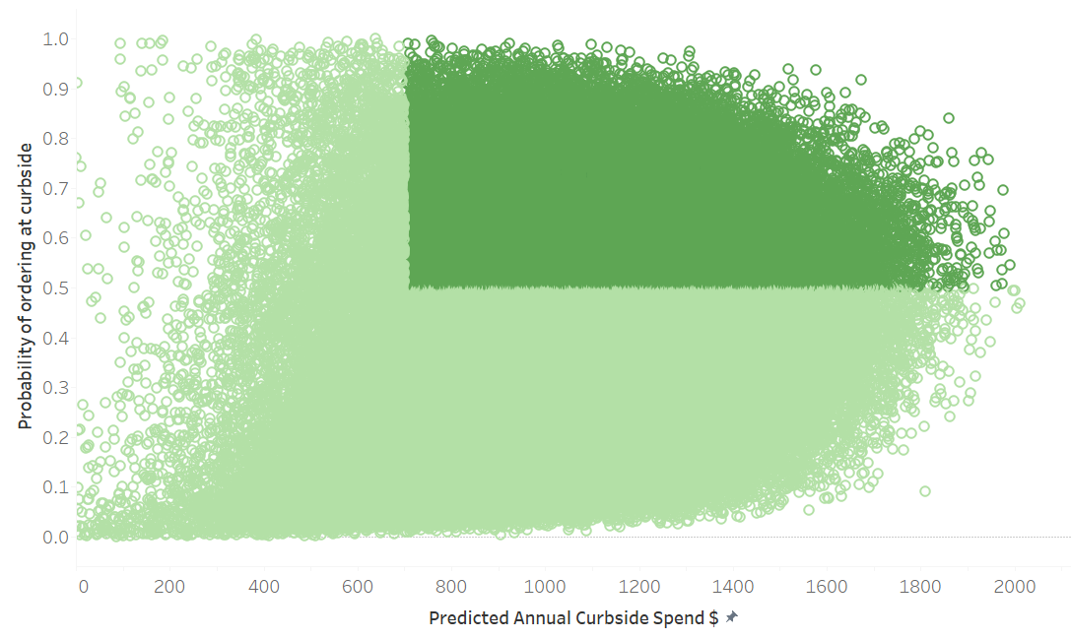
Curbside Likelihood Prediction
Approx 23%, i.e 64,445 households with more than 50% probability and $700 annual spend are expected to move to curbside from non-curbside.

Slide 31
Curbside Likelihood Prediction
Value Segmentation | Number of Households
Weekly | 28%
Super Frequent | 22%
Selective | 21%
Focused | 16%
Monthly | 12%
New | 1%
Note: Value Segmentation distribution is presented for 17,960 households out of the 64,445 households which are predicted to start curbside.

Slide 32
Results & Recommendations

Slide 33
Key Achievements
Segmented Pittsburgh-South, curbside households and created four distinct profiles for them
Created a model to predict the likelihood of non-curbside customers starting curbside
Identified value creating potential curbside customers

Slide 34
Recommendations
Design cluster specific marketing strategy for current curbside customers to effectively enhance the sales.
Strategize curbside marketing campaigns for predicted non-curbside with the highest probability to switch to curbside.
Reallocate marketing funds with the guidance of segments and curbside prediction model to achieve the desired objective.

Slide 35
Business Value
Efficient utilization of advertising funds based on targeted segments
Improve sales and customer experience through targeted marketing
23% of non-curbside customers are expected to switch to curbside with 50% probability and more than $700 spend
Word-of-mouth publicity and trust from current curbside customers

Slide 36
Q&A

Slide 37
Appendix

Slide 38
Buying Behavior - Data Cleaning
 | Factor | Measure (on a household basis) | Problem | Solution | Reason
1 | Purchase frequency | Number of curb/ non curb transactions | Null values | Replaced with 0s | Assuming no transactions for Null values
2 | Product mix | $spent/Category | Null values Negative values | Replaced with 0s | Assuming no transactions for Negative/ Null values
3 | Promotion Sensitivity | Promotion sensitivity score | Continuous variables and threshold to segment customers | Replaced values less than 98 to 1 and above to 0 | Assuming that households more sensitive will purchase more

Slide 39
Household Demographics - Data Cleaning
 | Factor | Measure (on a household basis) | Problem | Solution | Reason
1 | Income | Household Income | Null Values No categories | Replaced Nulls randomly in the same ratio as available data. Created 4 categories | Assigning any other value will skew the data Important for segmentation
2 | Age | Age of 1st individual | Null Values | Replaced Nulls randomly in the same ratio as available data. | Assigning any other value will skew the data
3 | # of Adults | # of young adults, # of senior adults | 7 Categories | Consolidation into 3 buckets | To get more significant results for segmentation

Slide 40
Household Demographics - Data Cleaning
 | Factor | Measure (on a household basis) | Problem | Solution | Reason
4 | # of Children | # of infants, # of pre-teens, # of teens | 5 Categories | Consolidation into 3 buckets | To get more significant results for segmentation
5 | Occupation | Occupation of 1st Individual | Missing 60% of data | Drop the field | Insufficient data
6 | Education | Education of 1st individual | Missing 41% of data 4 Categories | Replaced Nulls randomly in the same ratio as available data. Consolidated into 3 buckets | Assigning any other value will skew the data

Slide 41
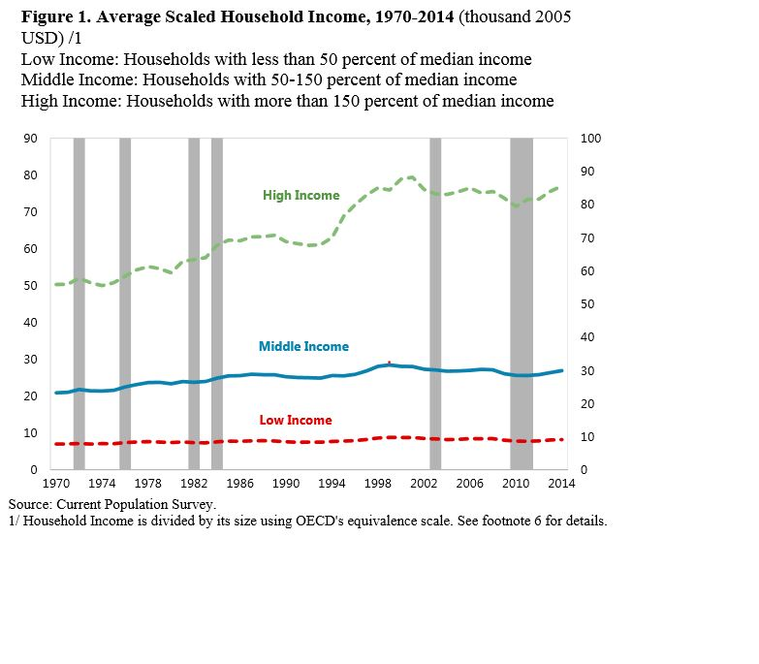
Income Segmentation
Lower : 0-30,000 USD
Lower Middle: 30,000-65,000 USD
Upper Middle: 65,000-100,000 USD
Upper: >100,000 USD
Based on Median US income: 65,000 USD approx.
Median Segmentation: IMF data*
< 50 % of Median
50-100 % of Median
100-150% of Median
>150% of Median
*https://www.imf.org/external/pubs/ft/wp/2016/wp16121.pdf

Slide 42
Education segmentation
Category 1: Completed High School Attended Vocational/Technical Training
Category 2: Completed College
Category 3: Completed Graduate School
Category | % of Households
Category 1 | 56.9%
Category 2 | 28.9%
Category 3 | 14.2%

Slide 43
Store Demographics - Data Cleaning
 | Factor | Measure (on a household basis) | Problem | Solution | Reason
1 | Competition | No. of competitors in a 10 mile radius from the primary store | Too many competitor stores for each GE store | Split into 3: 1 mile, 3 mile & 5 mile radius Split into local and national competitors | 10 miles is a very large radius
National Chains: Whole Foods, Aldi, Trader Joe’s, Walmart
Regional Chains: All other stores (including Save A Lot, Shop N Save, Marcs, etc.)

Slide 44
Key Deliverables
Python code to create a consolidated data file with curbside customers’ demographics and buying behaviour
Linear Regression model to predict curbside switching customers
Documentation to create the segmentation clusters and use the Linear Regression model
Slide deck

